Slide 1
In 5 Minutes
Alexander Rössler

Slide 2
Overview
Machinekit
Main Features
Applications
More Information

Slide 3
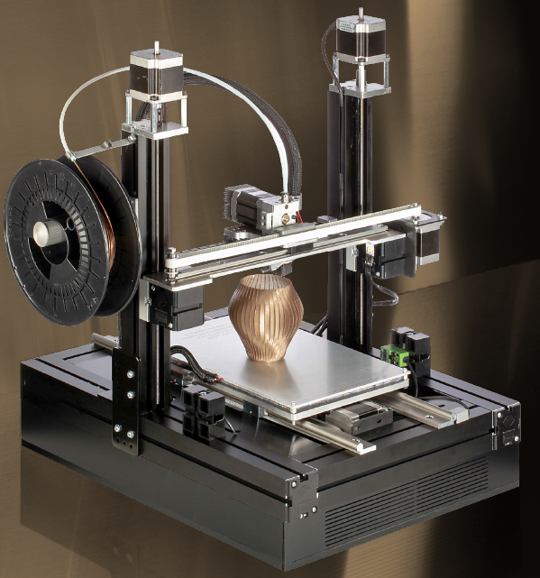
About Me
Alexander Rössler
Embedded Systems
OpenSource community
3D printing
The Cool Tool

Slide 4
What is Machinekit?

Slide 5
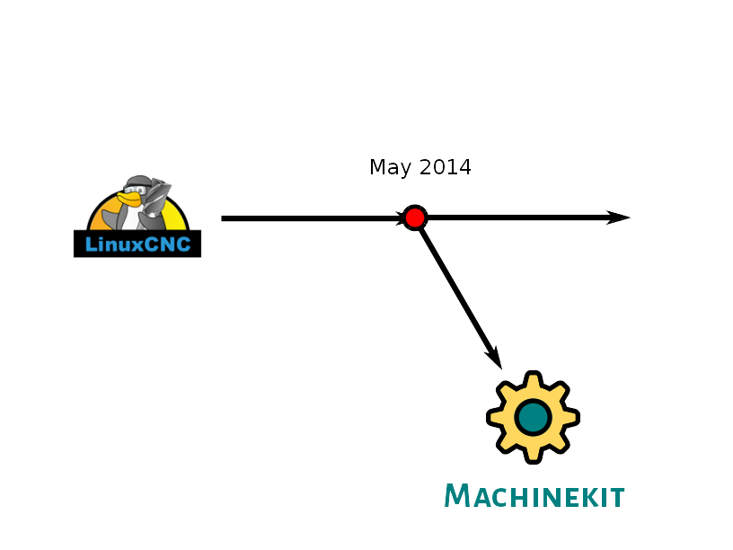
Roots

Slide 6
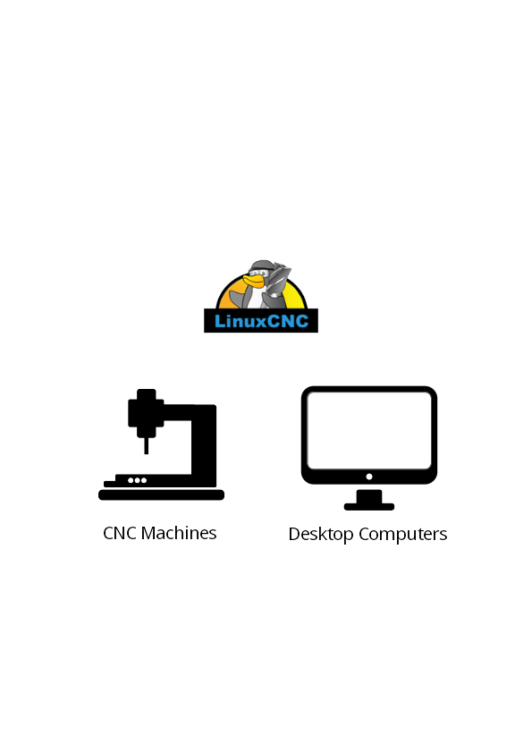
Roots

Slide 7
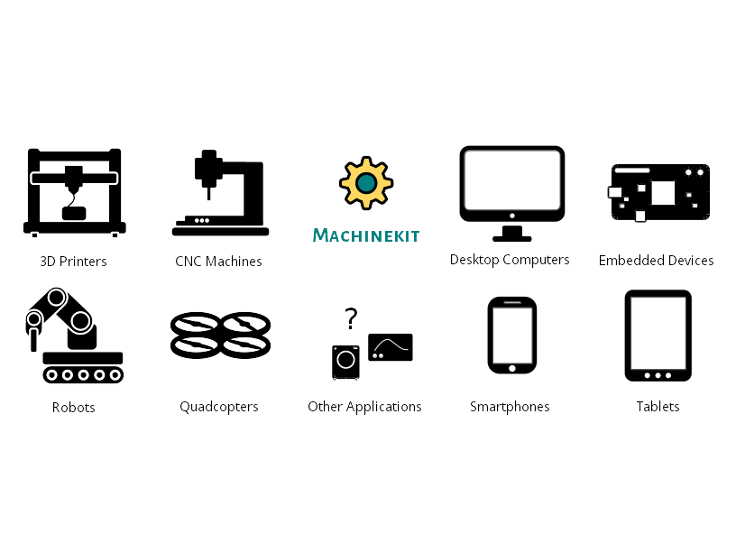
Applications

Slide 8
Main Features

Slide 9
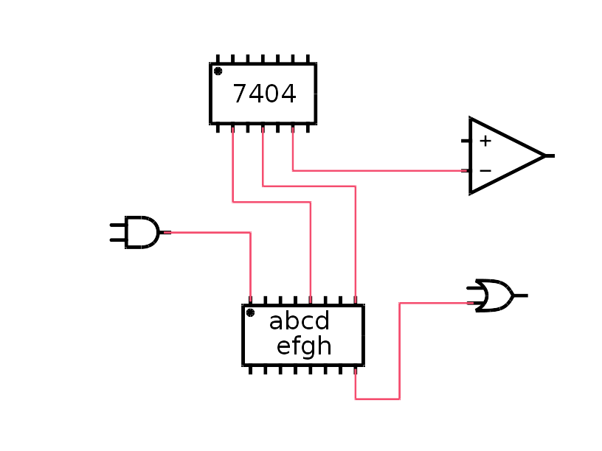
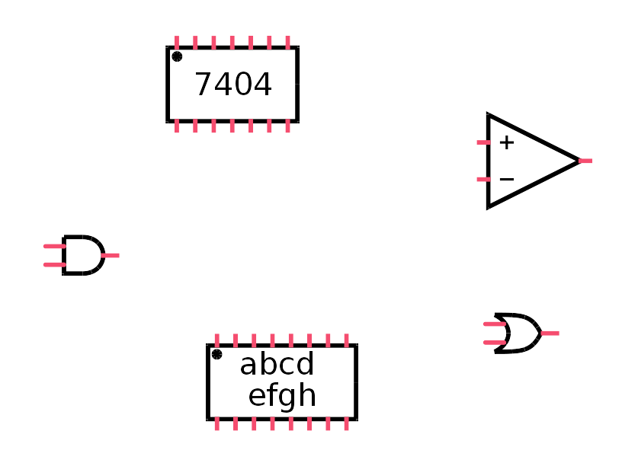
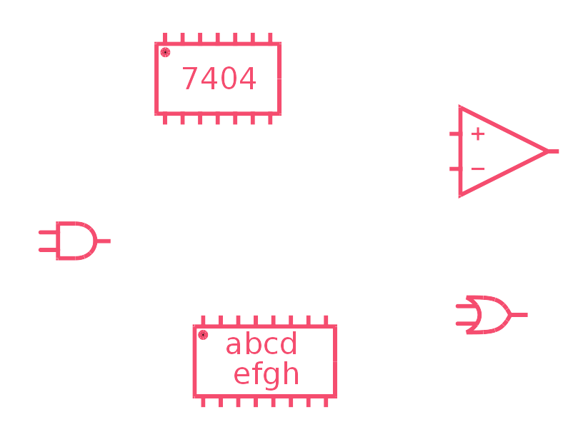
Hardware Abstraction Layer
Configuration
  Components
  Pins
  Signals
Realtime
Userland

Slide 10
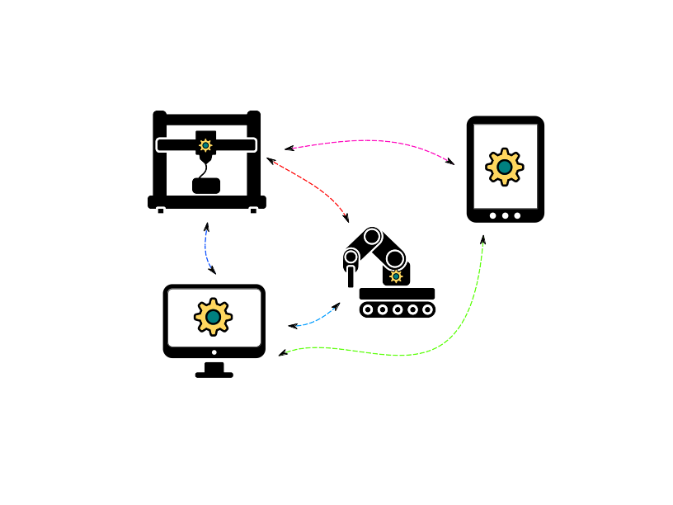

Machinetalk
Middleware
Interaction between RT and non-RT
Distributed setups

Slide 11
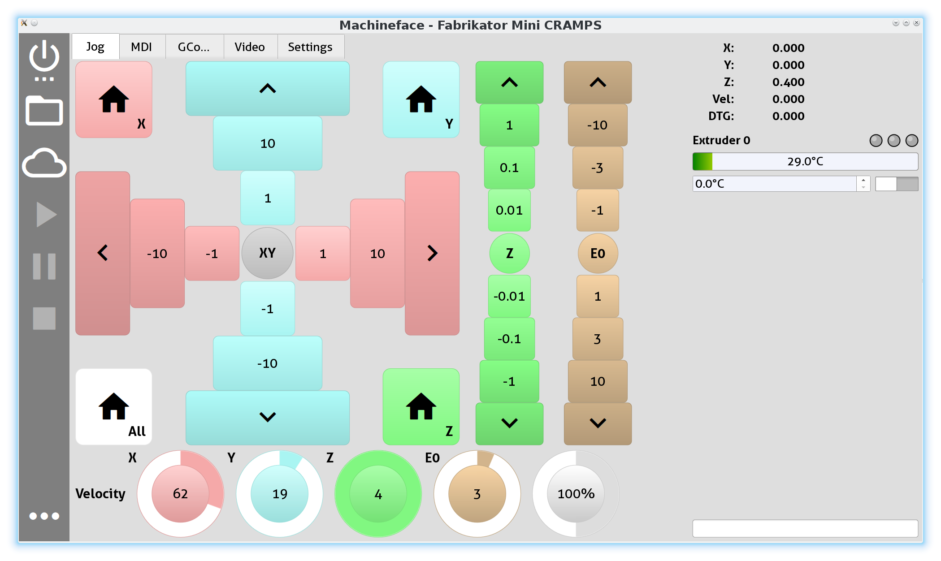
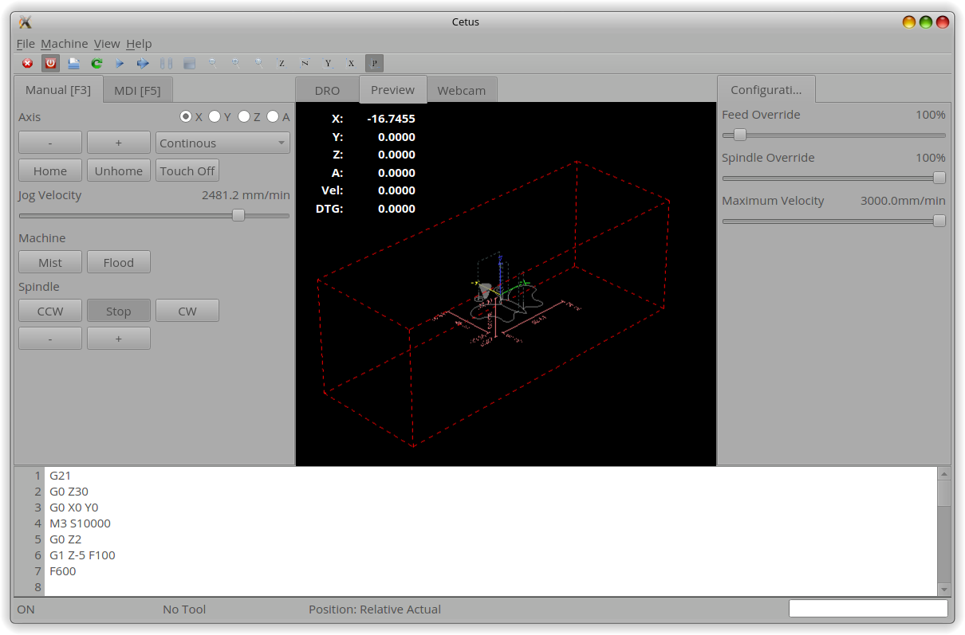
Remote UIs
QtQuickVcp
Machineface
Cetus
...

Slide 12
Application

Slide 13
In Action

Slide 14
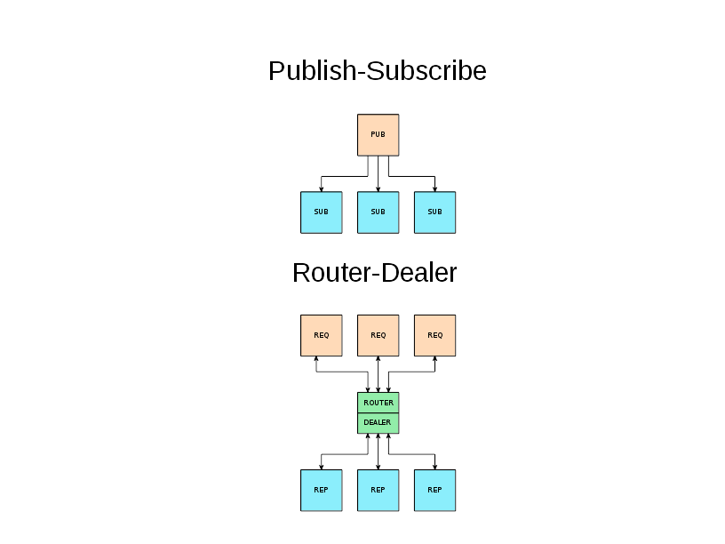
Transport
ZeroMQ
End-to-end
Communication patterns
Several transports (TCP, IPC, …)
No startup order dependency
Automatic reconnect

Slide 15
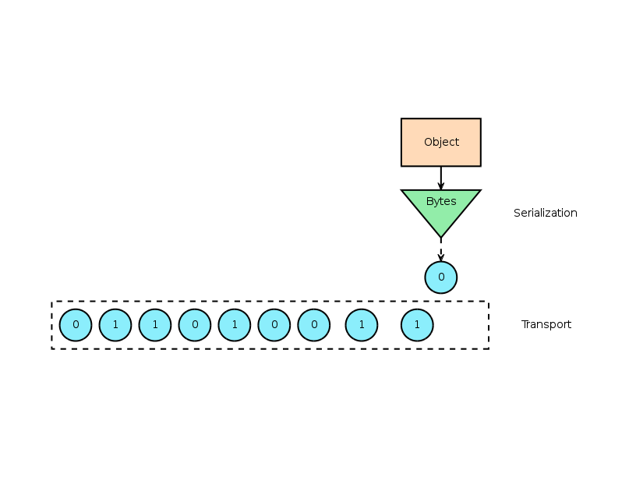
Serialization
Protocol Buffers
Wire format
Binary data
Highly optimized
RT: nanopb

Slide 16
Services
Instances organized in services
Distributed setups
Easy to extend

Slide 17
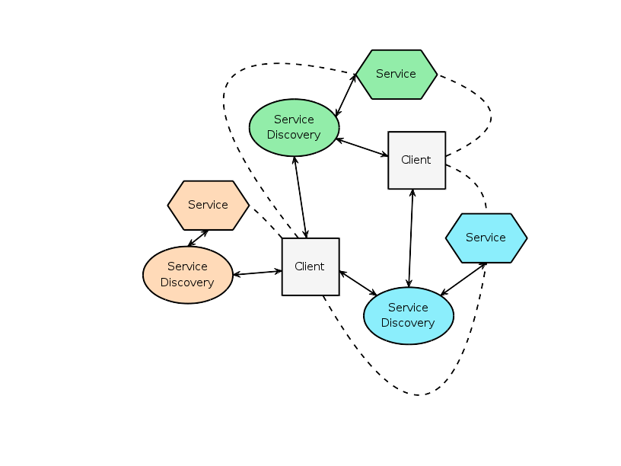
Service Discovery
MDNS/DNS-SD
Auto configuration
No user interaction
Decentralized
Multicast
Unicast

Slide 18
Webtalk
Bridge
Protobuf → JSON
ZeroMQ → websockets

Slide 19
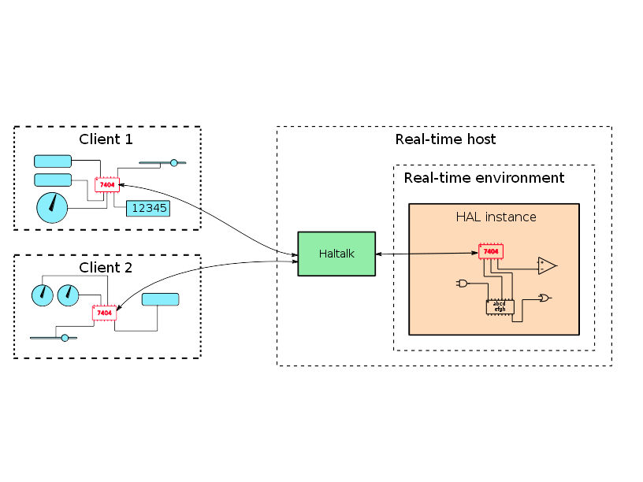
HAL Remote Component
Like normal components
Remote API

Slide 20
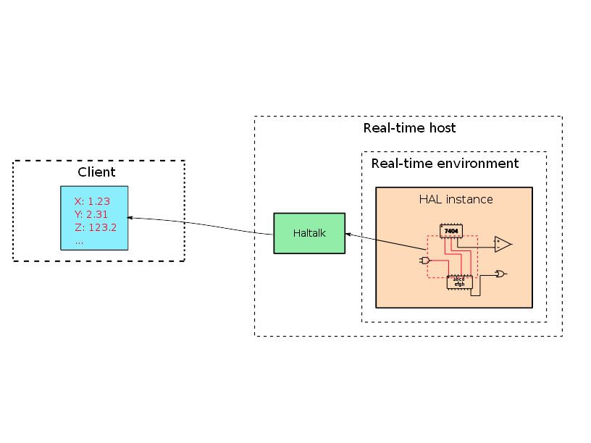
HAL Groups
Grouping signals
Value updates

Slide 21
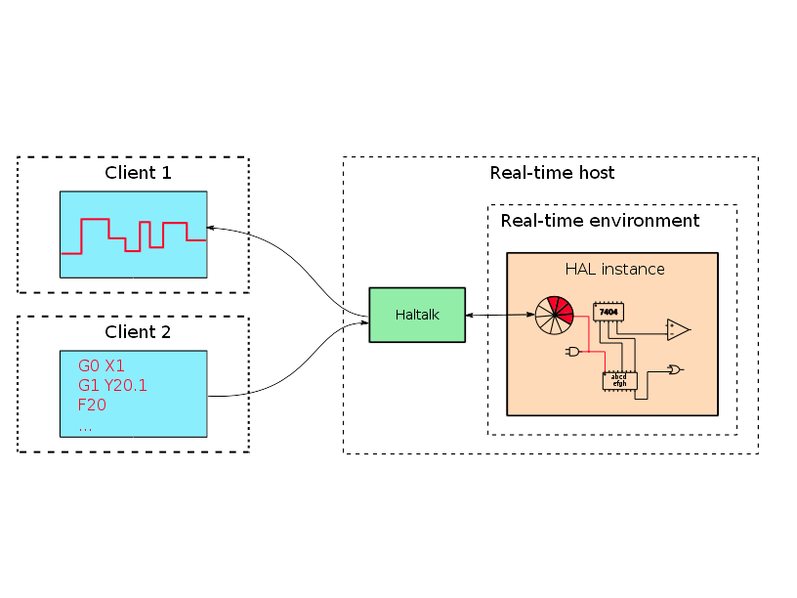
HAL Named Ring Buffers
Queued command and response
RT to non-RT interface

Slide 22
Showtime!

Slide 23
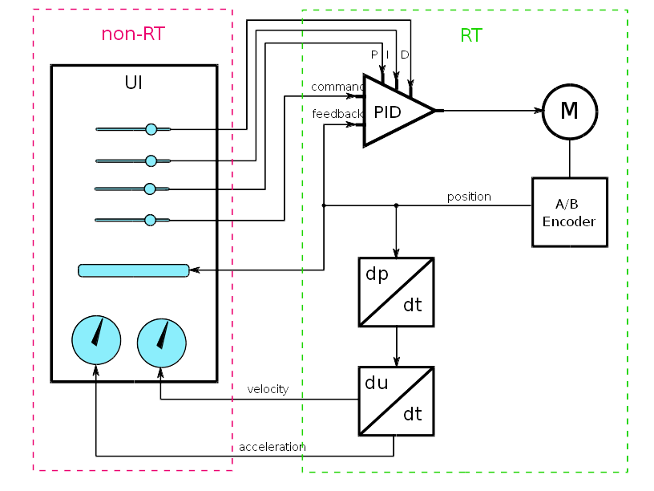
Demo

Slide 24
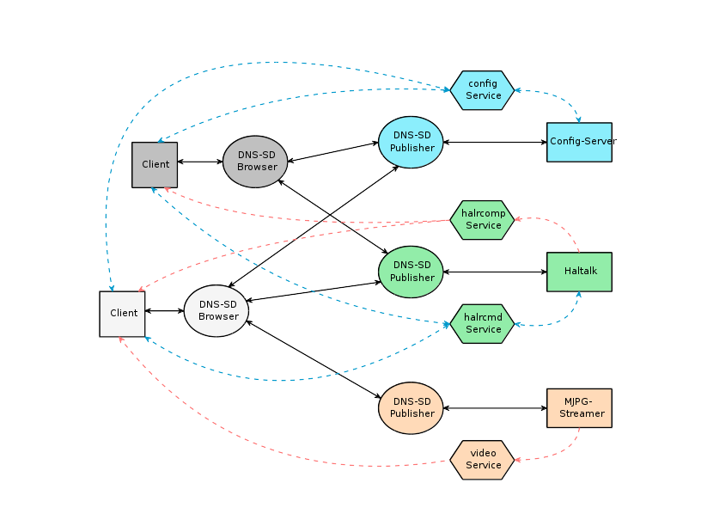
DEMO

Slide 25
More Information
machinekit.io
Machinekit on Google Google Groups
machinekoder.com
Meetup: Qt and QML Vienna

Slide 26
Questions?

